Slide 1
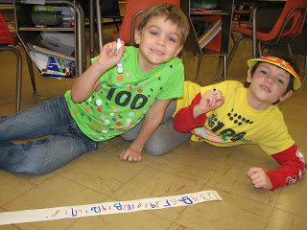
Kelsey Elementary School
After-School Activities

Slide 2
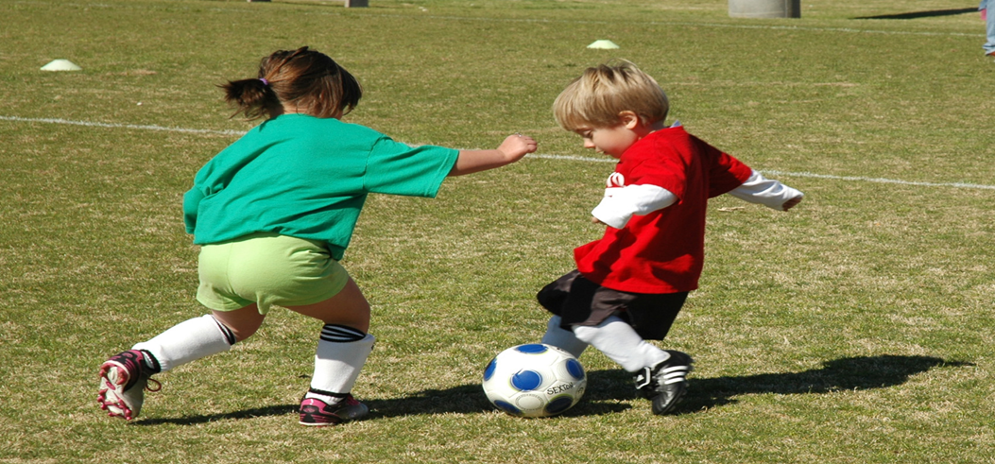


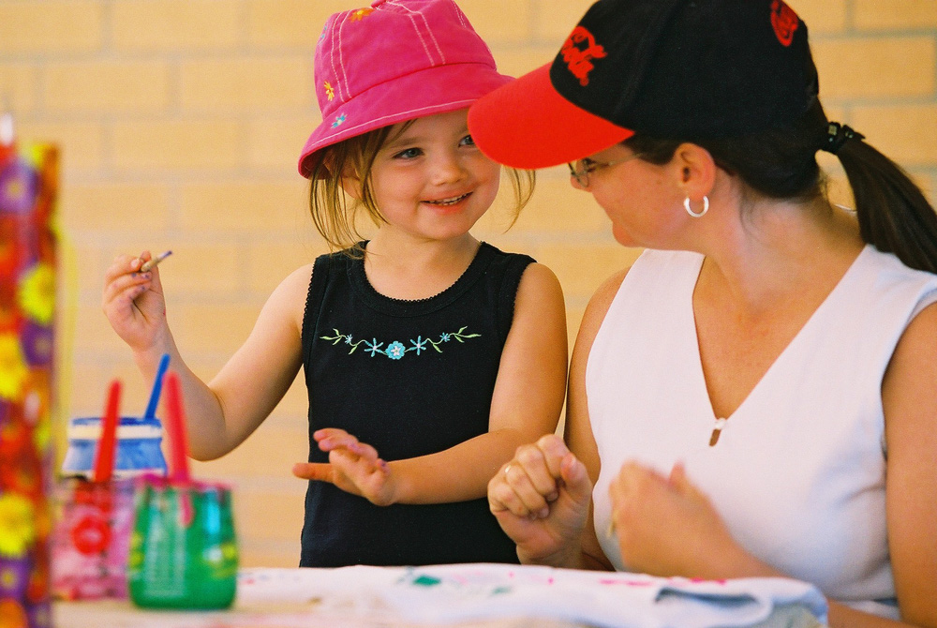
Notes:
Welcome to Kelsey After School Activities. Here at Kelsey Elementary School we offer students a wide range of after-school activities throughout the school year. Activities include indoor and outdoor free play, arts & crafts, sports, science, cooking, cooperative games, community service, dance, drama, and more! Children in grades 1 and up may sign up for our Homework Help program, where students can ask questions, have their homework/assignment notebooks checked, or get support from a Kelsey Elementary student mentor.

Slide 3

Kelsey After-School Activities Description
Sports – Gymnastics, ball Games,
The Arts – Painting, drawing and crafts
Drama – Learning to act, plays, readings
YMCA

Slide 4
What to Expect the First Days
Supplies for Class
Schedule
Breakfast and Lunch
Recess
Hours of Operation
Notes:
The supplies needed for class vary upon grade level. The supplies for students are kept in the supply closet. The typical finds in the supply closet for daily learning are: crayons, spiral notebooks, loose leaf paper, rulers, calculators, scissors, pencils, glue, and erasers. To help maintain the health of everyone in the classroom and to keep germs from spreading, Kleenex, paper towels, and hand sanitizer are also needed. For students in K4 and K5, additional supplies such as a change of clothes, in case of an accident, and a blanket for naptime are needed.
The classes are not divided into a schedule in the way that high school classes are. All students study English, math, science, and social science. There is also the addition of gym, music class, visits to the library, and the addition of a foreign language, such as Spanish or French, for third to sixth graders. The days in which the children go to the additional classes vary as the location is available as all classes share the rooms. Nevertheless, all basic lessons are taught every day.
Breakfast starts at 8:00am sharp for all students. For K4, K5, 1st and 2nd grade, lunch starts at 11:00am. For all other students, Lunch starts at 12:00pm. Kelsey School District participates in the National School Breakfast and lunch Program. All meals meet National Nutritional Standards. A “Menu Newsletter” is sent home every month with the prices for breakfast and lunch. Lunch can be paid for in the cafeteria or with a credit card through the website. If the child’s funds on the website are depleted, the cafeteria will front him/her a lunch and send home a reminder to replenish funds. The child will receive a peanut butter sandwich and milk until funds are added. You can see the nurse to find out how to receive reduced or free lunch.
Recess takes place for thirty minutes after lunch is ate. The children can play on the playground, or utilize the sports gear from the gym. On the days where the weather permits going outside, children are allowed to go back to class and watch an appropriate movie of the teacher’s choice. Children are encouraged to play fair and take turns at all times.
The school doors open and 8:00am. Supervisory of students is not held until this time so parents are discouraged of dropping off children before this time. School lets out at 3:00pm and children are asked to be picked up promptly if not riding school buses. Any child left after 3:30pm will be sent to the office and parents will be contacted.

Slide 5
Expectations continued
Location of Things
Library
Bathrooms
Lockers
Bus Stop
Bus Schedule
Notes:
The locations of the classrooms were placed in just a way so that the students and faculty can take full advantage of their time. A map of the school’s layout can be printed from the website, principal’s office, or form the receptionist.
The Kelsey Elementary School Library is designed to be an open library where students are free to come and go as they choose or need. Students come as a class, individually, or in groups to work, do research, brows, or read.
Bathrooms are located in several locations on the first and second level. There are also bathrooms in K4 and K5 classrooms, in the cafeteria, in the gym, and in the teacher’s lounge.
Lockers are only available on the first floor. Students are given five minutes before class begins to put things away in their lockers. When needed, children will be given permission to go to their lockers if materials are needed. There are between five and ten buses in total that bring children to and from school. The number of stops on each rough is determined by the amount of kids living in that area. The bus drivers are given the routes and are to familiarize themselves with it months before school start for students. Students are assigned to a specific bus route and bus to prevent the buses from being overcrowded. Please have your child wait at the appropriate bus stop. Remember students are to ride their assigned bus only. If a situation arises that requires your child to ride another bus, please but in a request in the principal’s office.
Buses begin picking up children as early as 6:30 am depending on how far they live from the school and how many children are to be picked up along the way. Parents are asked to have their children waiting on time so that they do not miss the bus. All drivers are requested to wait at the stop for no more than three minutes before continuing on to the next stop.

Slide 6

Student Safety is our #1 Goal
There is zero tolerance for bullying of other students which includes
To Tease one another
Fighting of sort
Throwing rocks or sticks
Intentionally impeding another students learning

Slide 7
Who Can Pick up My Child?
The school will only release your child to an authorized person
Who can be authorized?
Legal Guardians
Neighbors/Friends
Anyone over the Age of 18
How Do I authorize an adult?
Come to the main office
Fill out a form
Sign it and have it added to the child’s file

Slide 8
Tips for Improving Attendance
Step 1
Keep up on preventative care
Step 2
Fewer sick days
Step 3
More time in class leading to better grades

Slide 9
Parental Expectations
Child development is a #1 priority.
Parent/Teacher Association
Parent/Teacher Conferences
Notes:
We at Kelsey Elementary School are dedicated to the growth and development of your child in a safe, positive environment. As a parent, you are expected and encouraged to participate in this environment as much as possible; we aim to have an atmosphere of open communication where both students and parents can speak with staff at any time for any reason. Remember, you are just as essential to your child’s education as we are.

Slide 10

Parent/Teacher Association and Conferences
Parents are an essential part of their child’s development and education.
PTA activities are planned throughout the year.
Conferences can be held at the request of the parent or the teacher.
Notes:
We believe that a parent is an essential key to a child’s education and development. For this reason, Kelsey has a Parent/Teacher Association that we invite you to join. Activities are planned and occur throughout the year. This will provide a great opportunity for you to be involved in your child’s education.
In the same vein as our Parent/Teacher Association and related activities, we also hold Parent/Teacher conferences. General conferences for all parents are held twice per year; a typical conference will last 15 minutes; however, you may contact the office should you desire a longer conference. We encourage parents to take advantage of the conferences, as they provide excellent opportunities to speak with your child’s teachers
We also have conferences that can be scheduled individually, either by the parent or the teacher. The goal of these conferences is to communicate and discuss your child’s progress, whether there has been a positive or negative growth in their progress.

